Slide 1
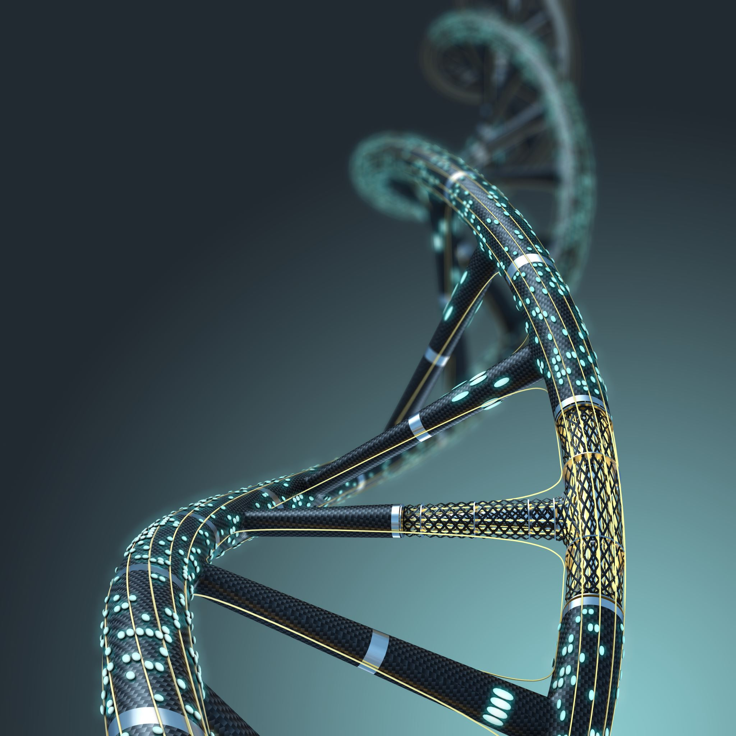
Cancer Classification
Fatemeh Asgarian
Dilma (Dia) Karunathilake
Noah Zeidenberg

Slide 2
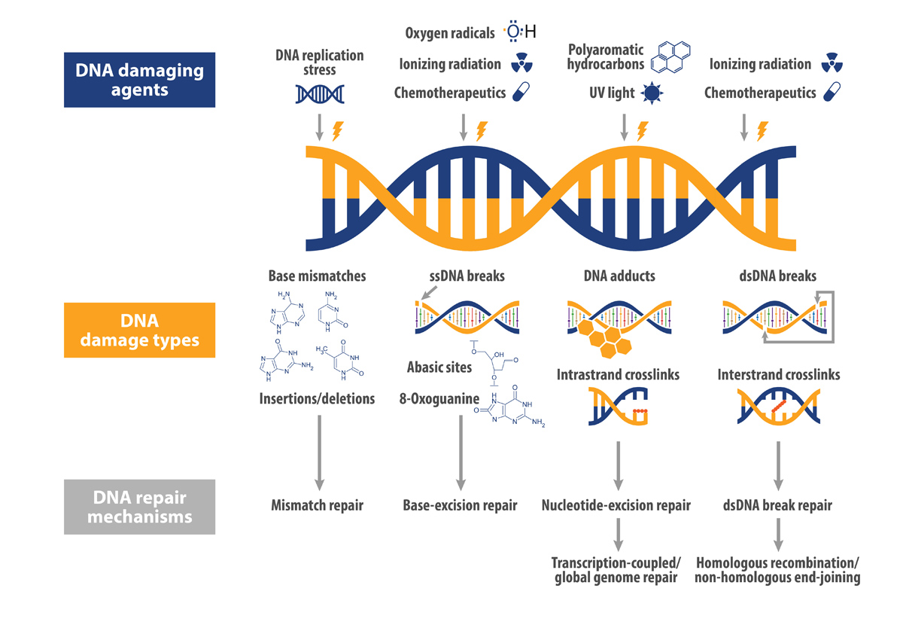
Genomic Integrity
DNA Repair Mechanisms¹:
Throughout our lives, cells acquire changes to the genetic information they hold.
These changes may be:
Exogenous
(e.g., radiation, chemicals, infections)
Endogenous
(e.g., replication errors, metabolic byproducts, genetic predispositions)
The maintenance of cell genomic integrity is handled by DNA repair mechanisms that address genetic damage.
From reference #2
Notes:
Throughout our lives, cells acquire changes to the genetic information they hold.
These changes may be exogenous (factors/substances that originate from within an organism) or endogenous (factors/substances that originate from outside an organism).
The maintenance of their genomic integrity is handled by DNA repair mechanisms that address genetic damage.
For example, if damage was done to a cell’s DNA through DNA replication stress and causes an ssDNA break, the Base-Excision repair pathway is a possible route for maintaining that cell’s genomic integrity.

Slide 3
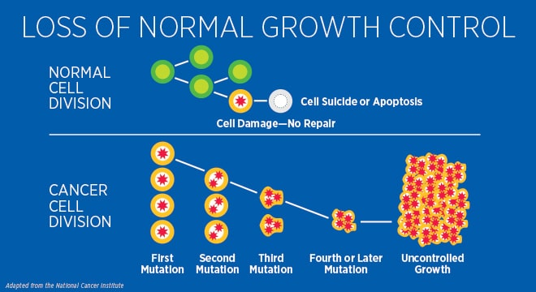
What is Cancer?
From reference #3
Notes:
Cancers are a group of complex diseases characterized by uncontrolled cell proliferation, resulting from genetic and epigenetic alterations that compromise genomic integrity.
Understanding how these changes disrupt genomic stability is crucial for developing effective cancer therapies and prevention strategies.

Slide 4

Cancer’s Impact on Genetic Integrity
What is Genomic Instability?
A phenomenon that is initiated by cancer and affects the progression of the disease⁴.
Genomic integrity lost due to DNA damage, failure of DNA repair mechanisms, and incorrect chromosome separation leading to genomic instability^{4, 5}.
Destabilized genome due to accumulated mutations and aneupoloidy⁴.
Result of Genomic Instability:
This leads to significant genetic imbalances that contribute to cancer progression, e.g., deactivation of p53 genes⁴.
Genomic instability patterns are used as biomarkers¹.
Created with BioRender.com
Notes:
Aneuploidy is the presence of an abnormal number of chromosomes. o further address this, cancers compromise genetic integrity through genomic instability. Genomic instability is a phenomenon that is initiated by cancer, speeds up the growth of cancer, and affects the progression of the disease. For example, centrosome amplification and DNA damage are both advantageous for cancer cell formation. The destabilization of the genome promotes tumorigenesis and loss of genetic integrity by enabling further mutations, for example the deactivation of tumor suppressor genes. One important thing to note however is that genomic instability patterns can often serve as biomarkers for identification of tumors sensitive to specific therapeutics of genetic deficiencies.
Studies show that high mutation rates, driven by the failure of DNA repair mechanisms, contribute significantly to genomic instability
Kotsopoulos et al. 2019

Slide 5
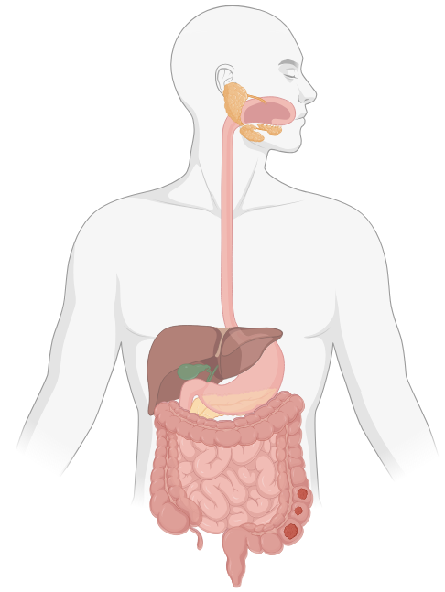
Understanding Different Cancer Types
Colorectal Cancer
Affects the digestive system
4th most diagnosed cancer in Canada in 2024⁶
2nd and 3rd leading cause of death from cancer in men and women respectively⁶
Created with BioRender.com
Notes:
Before we get into the nitty and gritty of the presentation, I thought I would briefly shed some light on the three different cancer types our dataset consists of and the importance of conducting research about them. Colorectal cancer begins in the cells of the colon or rectum which are parts of the large intestine and the digestive system.
Statistics say: 25,200 Canadians which is 10% of all new cancer cases in 2024 will be diagnosed with colorectal cancer and 9,400 Canadians which is 11% of all cancer deaths in 2024 will die from colorectal cancer.

Slide 6
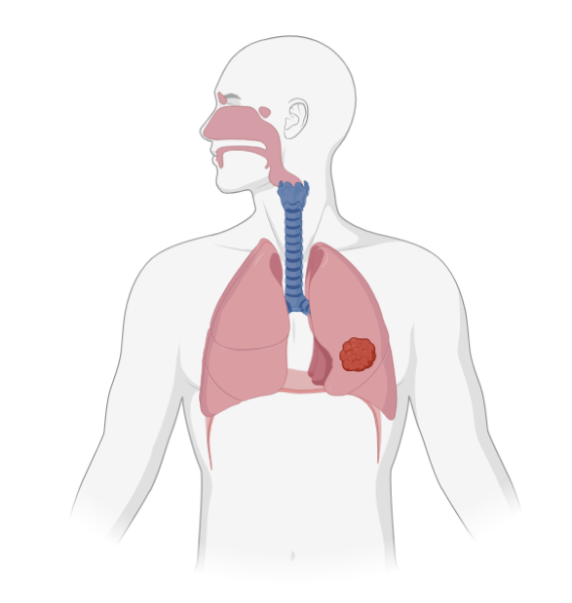
Understanding Different Cancer Types
Lung Cancer
Affects the respiratory system
~72% of lung cancer cases in Canada are caused by smoking tobacco⁷
The most diagnosed cancer in Canada⁸
The leading cause of death from cancer for both men and women in Canada⁸
Created with BioRender.com
Notes:
The lung is part of the respiratory system. Non–small cell lung cancer/Small cell lung cancer. Linked heavily to smoking.
When someone breathes in asbestos, they can get trapped in the lungs.
Statistics say 32,100 Canadians will be diagnosed with lung cancer, representing 13% of all new cancer cases in 2024. 20,700 Canadians will die from lung and bronchus cancer, representing 23% of all cancer deaths in 2024. On top of that, predictions say that that about 1 in 14 Canadian men will develop lung cancer in their life and 1 in 20 will die from it.

Slide 7
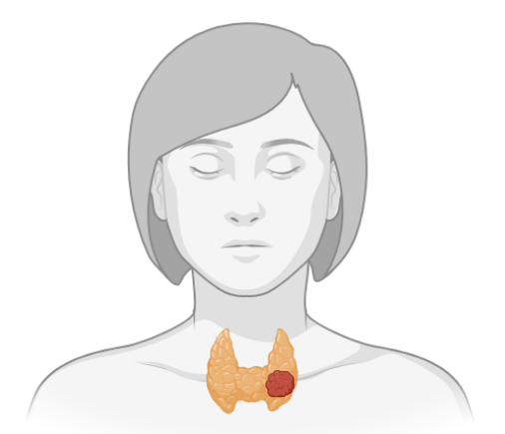
Understanding Different Cancer Types
Thyroid Cancer
Affects the endocrine system
In 2024, 6,600 Canadians diagnosed with thyroid cancer and 280 fatalities from thyroid cancer⁹
0.4% of cancer deaths in women and 0.3% of cancer deaths men¹⁰
Created with BioRender.com
Notes:
The thyroid is part of the endocrine system. It is a small gland in the front of the neck below the larynx (voice box) and near the trachea (windpipe). Exposure to radiation.
Canadian Cancer Statistics 2023.

Slide 8
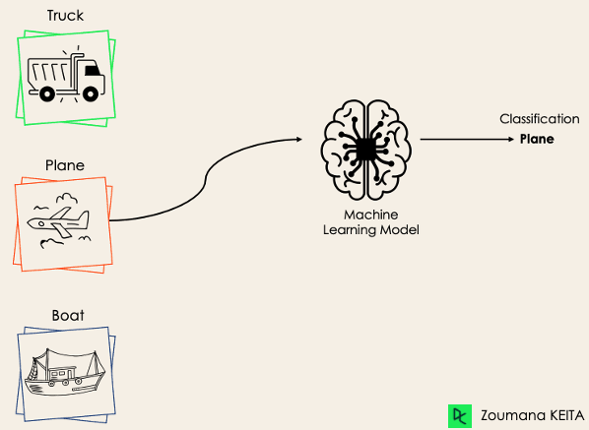
What is a Classifier?
In machine learning, a classifier is any model that categorizes or predicts labels based on input data¹¹.
From reference 11
Notes:
In machine learning, a classifier is any model that categorizes or predicts labels based on input data¹¹.

Slide 9
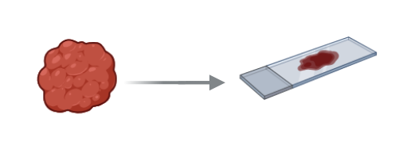
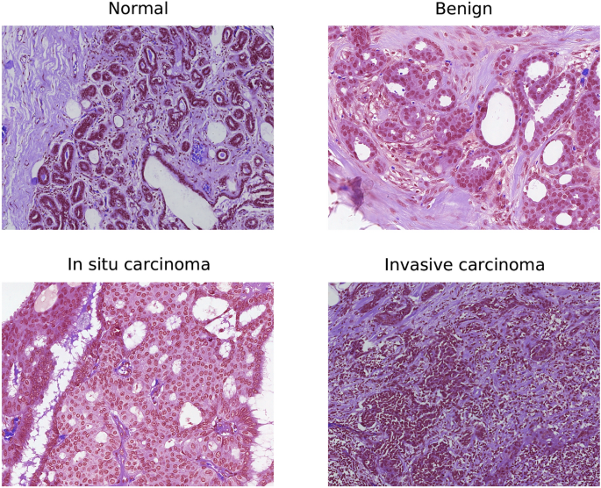
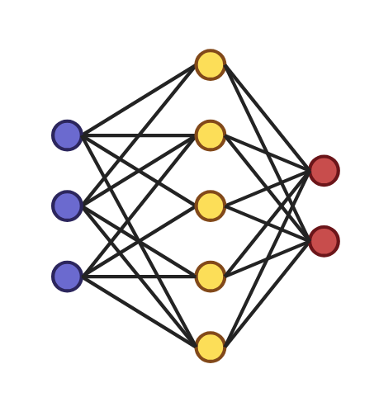
Benefits of Classifiers
The Past:
Histopathology
Present:
Classification
Important for diagnosis and treatment: Advantages include biomarker identification and identification of targets for specific drugs
From Reference 12
Created with BioRender.com
Notes:
In the past, we relied on human-dependent histopathology involves manual examination of tissue samples under a microscope to identify cancerous changes based on trained pathologists' observations.
In contrast, using classifiers to analyze DNA sequence data employs machine learning algorithms to identify patterns and mutations associated with cancer. This approach can provide a more objective and quantitative assessment, which potentially increases detection accuracy and efficiency while reducing human error.

Slide 10
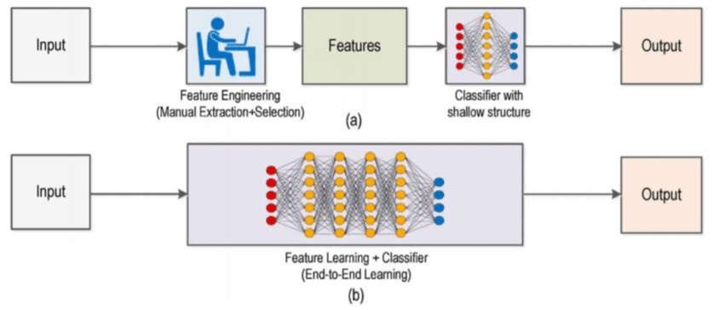
Types of Classifiers
Conventional Machine Learning Models¹⁴:
Simpler & less computationally intensive.
Struggle with complex, high-dimensional data.
Require extensive feature engineering.
E.g., Bayesian classifiers, regression models, and K-Nearest Neighbors (KNN).
Deep Learning Models¹⁴:
Automatically learns useful patterns from raw data.
E.g., Convolutional Neural Networks (CNNs) and Bi-directional Long Short-Term Memory Networks (Bi-LSTM) (RNN).
From Reference 13
Notes:
Conventional Machine Learning Models:
Simpler & less computationally intensive.
Works well for many structured data tasks but may struggle with complex, high-dimensional data such as genomic sequence data.
E.g., Bayesian classifiers, regression models, and K-Nearest Neighbors (KNN).
Require extensive feature engineering (manual input from experts to define relevant data features).
Deep Learning Models:
Deep learning can automatically learn useful patterns from raw data without as much human intervention, thanks to advancements in algorithms and computing power.
E.g., Convolutional Neural Networks (CNNs) and Bi-directional Long Short-Term Memory Networks (Bi-LSTM) (a type of recurrent neural network (RNN))

Slide 11
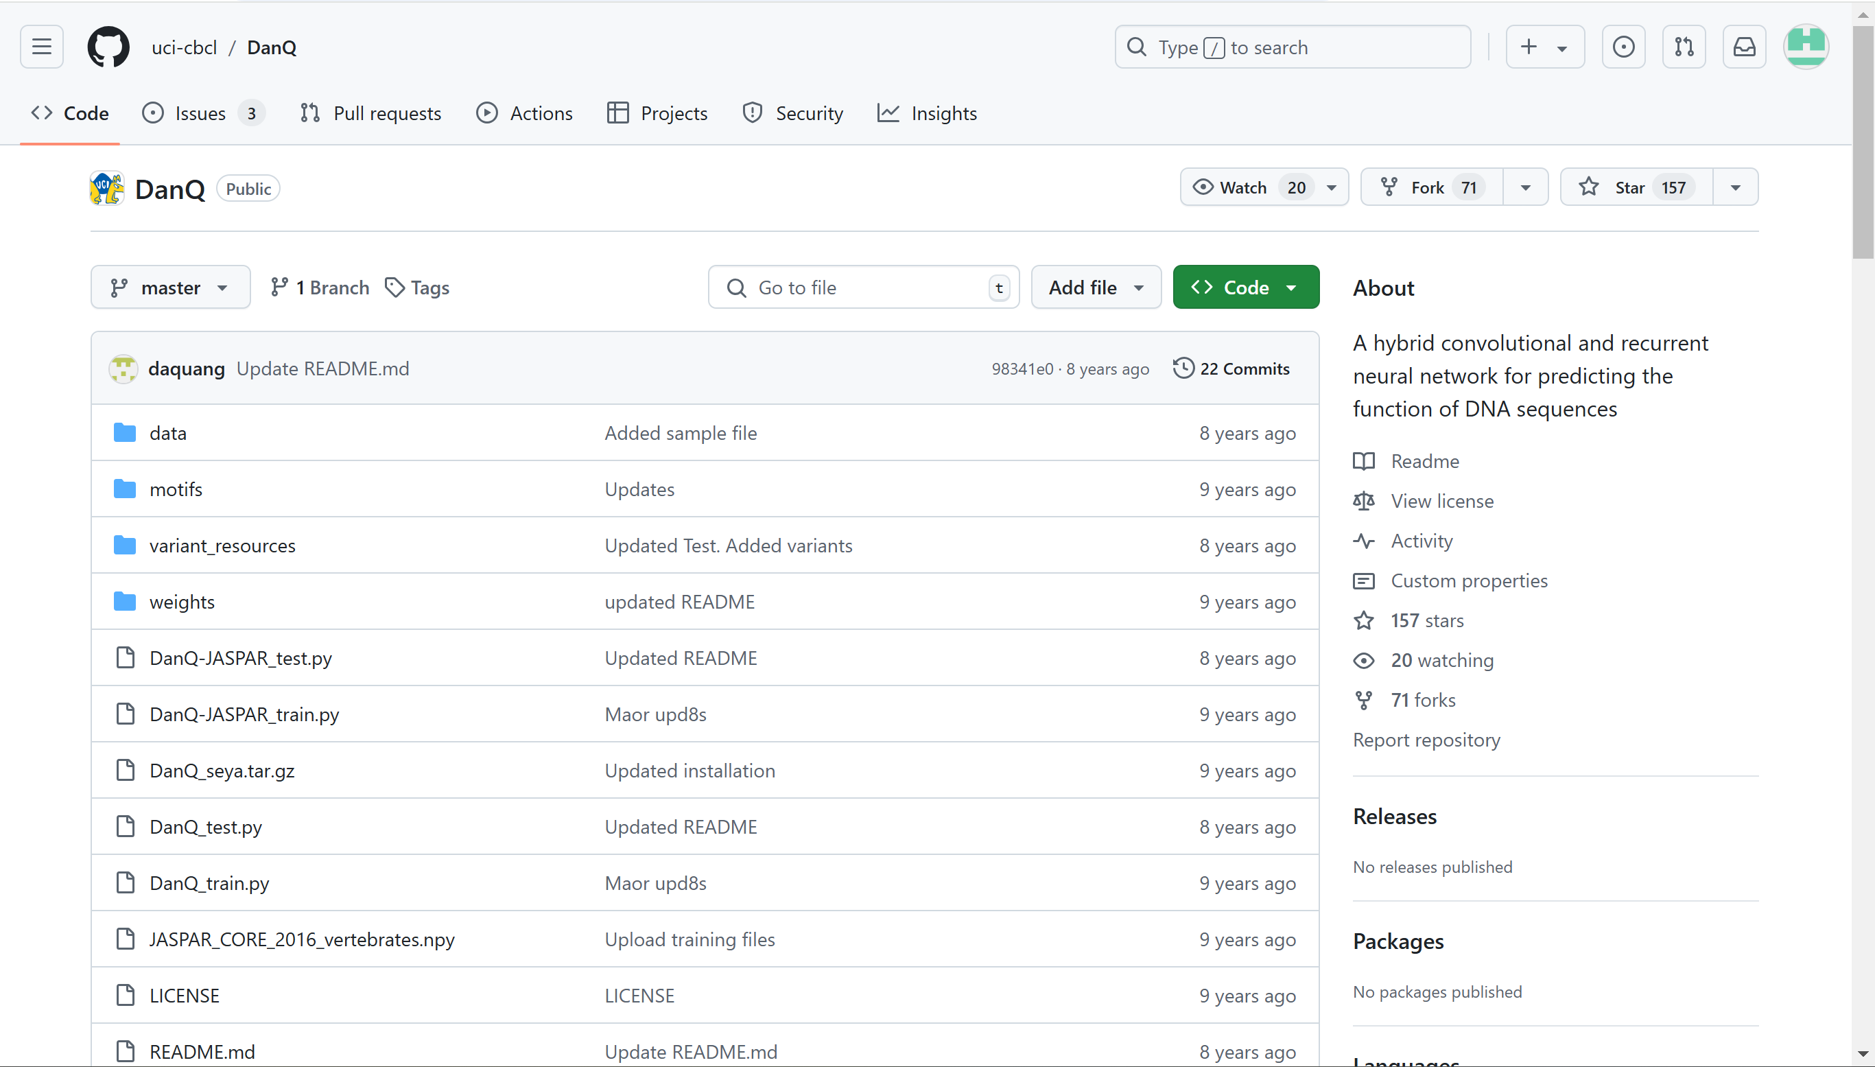
Project Objective
Use a hybrid CNN/RNN deep learning model to classify cancer types using DNA sequence data.
Notes:
As we’ve learned, the various types of cancers are caused by specific changes in the DNA or the gene expression of certain cells. These specific changes act as patterns that the classifier can identify and detect in order to define a sequence as belonging to a certain cancer type.
The objective of our project is to use a hybrid CNN/RNN deep learning model to classify cancer types using DNA sequence data.
The DanQ hybrid model (which we used as a reference to create our own) combines CNN and Bi-LSTM deep learning models¹⁴:
Convolution Layer: Recognizes patterns in data (like sequence data) with a grid-like structure. CNNs use layers of filters, or "convolutions," that scan small sections of data to detect important features.
Recurrent Layer: This layer captures dependencies between kmers. By reading in both forward and backward directions, it captures the full context, which improves classification accuracy.
After training, the model can classify a new DNA sequence into one of the three cancer types by identifying which learned patterns best match those in the new data.

Slide 12
Methodology

Slide 13
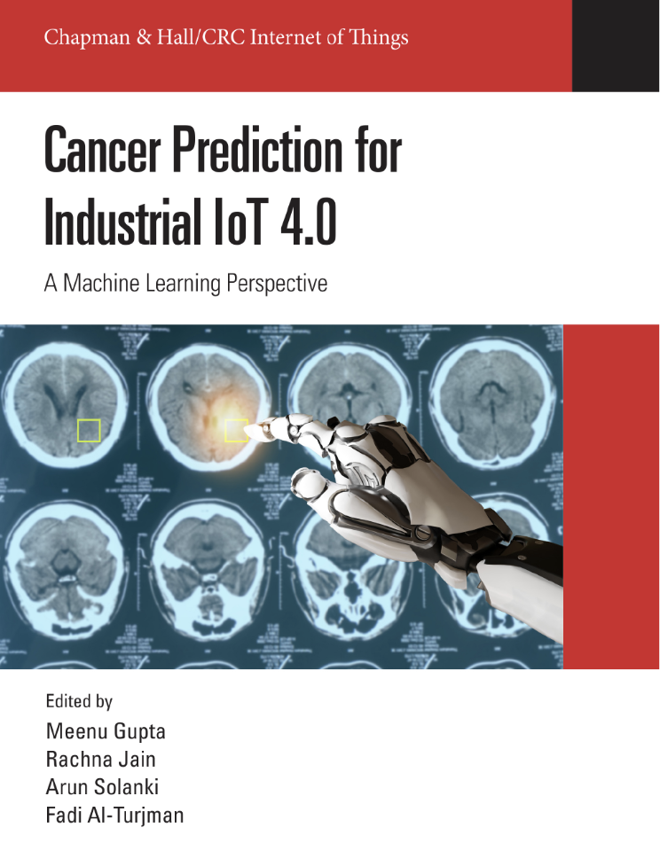
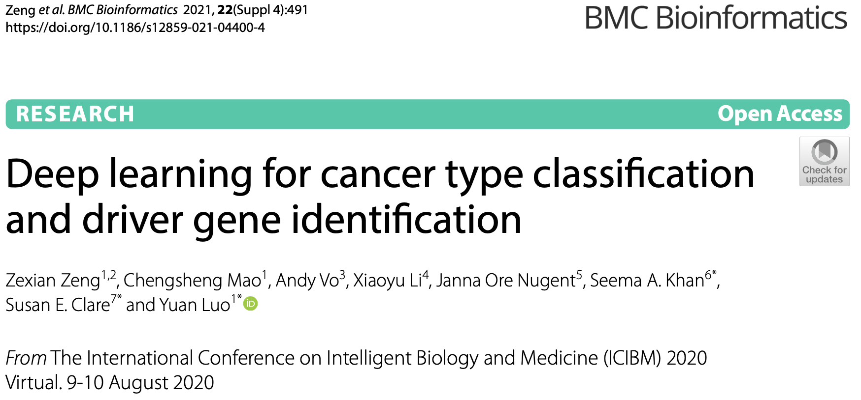
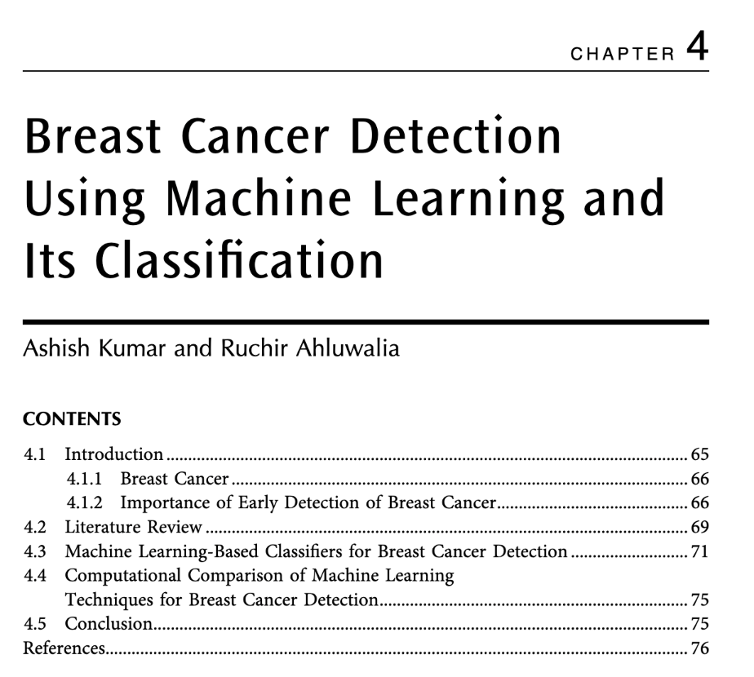
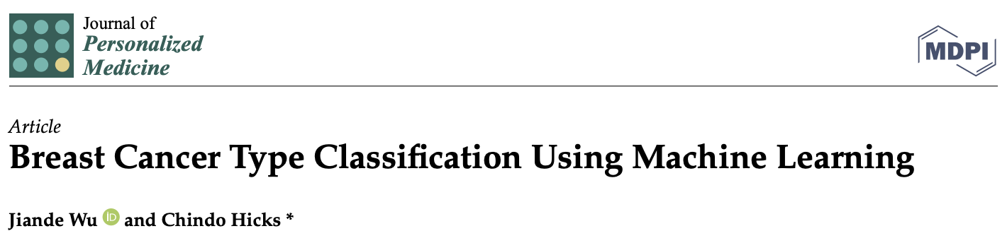
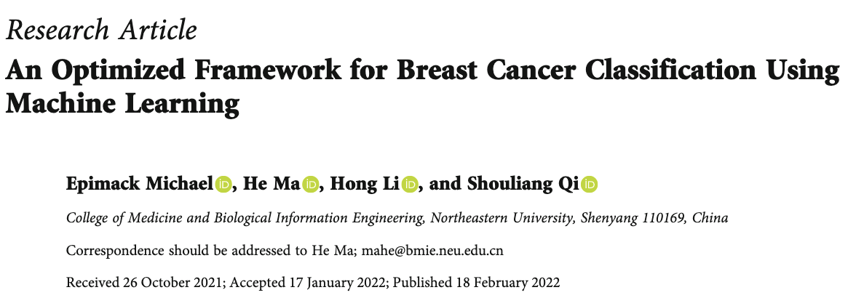
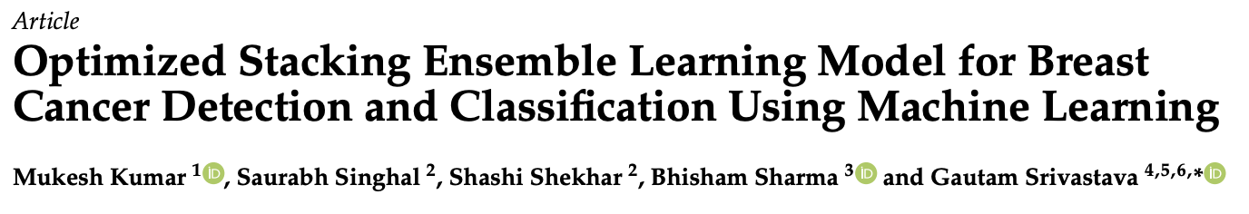
The Shoulders of Giants
Notes:
So as we know from class there are many classification methods, and more that we didn’t have time to cover. And for an overview presentation on classification of cancer-derived DNA sequences, it can be very easy to get overwhelmed by all the options available (at least that was my experience).

Slide 14
Which Algorithm or Model to Choose?
What question are you asking?
What does the data look like?
Notes:
There are many factors one might consider when choosing a classification method. In a real-world context some of the questions you might ask when deciding on a classifier would be what type of data are you classifying, and what does it look like.

Slide 15
Which Algorithm or Model to Choose?
How much computational power do you have?
What question are you asking?
How powerful do you need your results to be?
What does the data look like?
Do you need to know exactly what's happening within the model?
Notes:
You would also need to consider how interpretable your model and results need to be as well as the statistical power of your results if it’s for a clinical application. And we also had to consider how much computational power we had available, in our case 8GB of RAM would decide our model parameters which is less than ideal as you'll see in our results.

Slide 16

Our Model
Classification Problem
❌ Bayesian Classifier
❌ Regression models
❌ K-nearest neighbour
Complex Patterns
High-Dimensional Data
DNA sequence data
✅ Deep Neural Network
Notes:
So the type of data we were classifying was DNA sequence data, but specifically they were 16 kbp sequences that potentially contained both exons and introns, with the location of the exons in each sequence being unknown. That means there are potentially complex patterns in the data that an ordered sequential model would not be able to pick up on, if it was assuming that patterns were in the same place in all the data. Moreover this is very high-dimensional data, even at only 16 kbps there’s only so much you can do on 8GB of RAM so the classification method needed to be efficient at processing high-dimensional data.
Given these two requirements we could not use a Bayesian classifier as they assume independence of features which is violated in DNA sequence data, we could not use a regression model as it assumes linearity of the data which is violated in DNA sequences and is computationally inefficient for high-dimensional data, and K-nearest neighbours also is computationally inefficient for high-dimensional data so I likely wouldn’t even be able to run it. However, Deep Neural Networks have the capacity, depending on the type of layers you include, to parse complex patterns from the data without assuming independence or linearity, even in high-dimensional data.

Slide 17
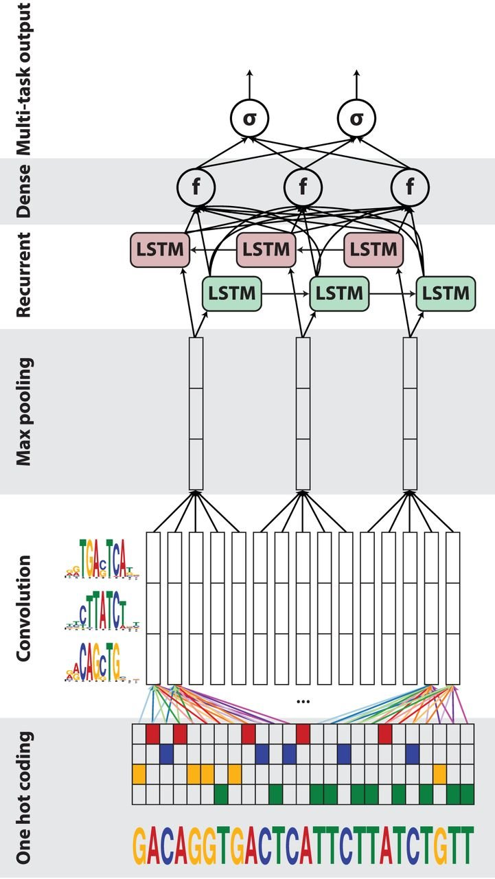
Our Model
Modified from Quang, D., and Xie, X. (2016)
4xN encoding | 128 filters, 16 kernels, step size 1 | Window size 13, Step size 13 | 128 forward + backward neurons | 512 neurons | 3 outputs
Notes:
So this is a figure modified from the DanQ paper, I just wanted to show this so you have an idea of what the model looks like inside but the specifics of the model are quite outside the scope of this course and most people’s background. But if anyone has any questions I’m happy to speak about it more.

Slide 18
Preliminary Performance Results
True Value
3-mers | Colorectal | Lung | Thyroid
Colorectal | 11 | 1 | 2
Lung | 0 | 5 | 0
Thyroid | 0 | 0 | 11
Predicted Value
True Value
7-mers | Colorectal | Lung | Thyroid
Colorectal | 17 | 0 | 0
Lung | 0 | 9 | 0
Thyroid | 0 | 0 | 19
Predicted Value
Notes:
So originally we weren’t using k-mer counts as features, we were just letting the model pick out features from individual nucleotides but that’s just under ten million data points and my computer kept crashing so instead we compared the performance of different sized k-mers with a small random forest classifier. And 7-mers performed well so we proceeded with that.

Slide 19
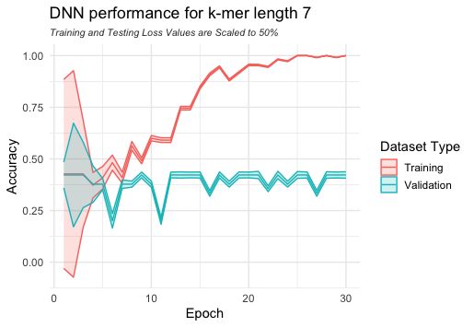
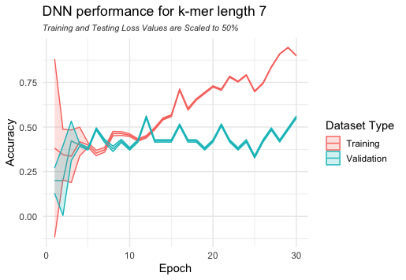
Performance Results
Very-low performance parameters
Low performance parameters
Notes:
That said, my computer did really struggle to run this model, the highest parameters I was able to use still only allowed for a very coarse-grained model but we felt it was more interesting that just using a random forest classifier since most of us have been working with those in our other classes. You can see that over each iteration or epoch the performance accuracy improves and the loss decreases. The loss, for those that aren’t familiar is an error measure, so the model is trying to maximize accuracy and minimize loss at each epoch. The loss for both training and testing data is displayed as shaded margins around the accuracy lines, and is scaled down by 50% just for neatness. We can see that regardless of the parameters used the models both increase in accuracy for the training data, but plateau early on for the testing data. So in short, neither model performs particularly well as a classifier, and given more time we would have tried more epochs, changing parameters around etc. but as an overview presentation we didn’t feel that was appropriate.

Slide 20
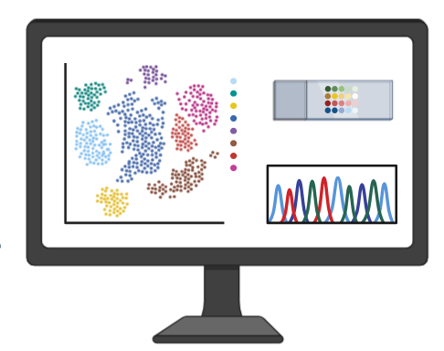
Limitations
Limitations of our project include:
Low computational power
Bias towards certain classes
Overfitting
Difficult to interpret
Complex model
Created with BioRender.com
Notes:
My computer has 8GB of RAM so there are computational power limitations. Greater computational power can improve the efficiency, speed, and accuracy of our classification. It will also allow for handling of larger datasets. The classes are not evenly distributed so there may be some biases towards thyroid and colorectal cancer with about twice the number of sequences. The dataset we are working with is quite small so overfitting occurring is a sign that the patterns are not being correctly identified. The complex nature of the model makes it difficult to interpret every calculation in a legible way. It is more complex to build than simpler models like randomForest and a regression model cannot be applied to it.

Slide 21
Future Work
Future Work:
Feature Extraction: Spaced Seeds
Add additional layers (CNN/RNN).
Integrate additional data types.
Real-world validation
Notes:
A few possible improvements to our models could be adding…
Feature Extraction: Spaced Seeds: Using spaced seeds would potentially allow for more noise or variation in each kmer while remaining highly sensitive to patterns.
Add Additional Layers: Experiment with adding extra convolutional or recurrent layers to capture more complex features.
Integrate Additional Data Types: Include other features, such as gene expression or methylation data, if it’s available, to provide further context and improve classification accuracy.
Real-world Validation: Test model accuracy across larger, diverse datasets for clinical relevance.

Slide 22

Questions?

Slide 23
References
Nik-Zainal, S. From genome integrity to cancer. Genome Med 11, 4 (2019). https://doi.org/10.1186/s13073-019-0617-y
Crown Bioscience. (2024). DNA damage response and repair in cancer [Image]. Crown Bioscience. https://blog.crownbio.com/dna-damage-response-and-dna-repair-in-cancer
American Association for Cancer Research. (n.d.). What is cancer? [Image]. American Association for Cancer Research. https://www.aacr.org/patients-caregivers/about-cancer/what-is-cancer/
Ferguson, L. R., Chen, H., Collins, A. R., Connell, M., Damia, G., Dasgupta, S., Malhotra, M., Meeker, A. K., Amedei, A., Amin, A., Ashraf, S. S., Aquilano, K., Azmi, A. S., Bhakta, D., Bilsland, A., Boosani, C. S., Chen, S., Ciriolo, M. R., Fujii, H., … Maxwell, C. A. (2015). Genomic instability in human cancer: Molecular insights and opportunities for therapeutic attack and prevention through diet and nutrition. Seminars in Cancer Biology, 35(Suppl), S5–S24. https://doi.org/10.1016/j.semcancer.2015.03.005
.Hopkins, J. L., Lan, L., & Zou, L. (2022). DNA repair defects in cancer and therapeutic opportunities. Genes & Development, 36(5–6), 278–293. https://doi.org/10.1101/gad.349431.122
Colorectal cancer statistics. (2024, May). Canadian Cancer Society. Retrieved October 28, 2024 from https://cancer.ca/en/cancer-information/cancer-types/colorectal/what-is-colorectal-cancer
Risk factors for lung cancer. (2020, May). Canadian Cancer Society. Retrieved October 28, 2024 from https://cancer.ca/en/cancer-information/cancer-types/lung/risks
Lung cancer statistics. (2024, May). Canadian Cancer Society. Retrieved October 28, 2024 from https://cancer.ca/en/cancer-information/cancer-types/lung/statistics
Thyroid cancer statistics. (2024, May). Canadian Cancer Society. Retrieved October 28, 2024 from https://cancer.ca/en/cancer-information/cancer-types/thyroid/statistics
Canadian Cancer Statistics 2023. (2024). Canadian Cancer Society. Retrieved October 28, 2024 from https://cancer.ca/Canadian-Cancer-Statistics-2023-EN
DataCamp. (2024). Classification in machine learning: A guide for beginners [Image]. DataCamp. https://www.datacamp.com/blog/classification-machine-learning
Hameed, Z., Garcia-Zapirain, B., Aguirre, J. J., & Isaza-Ruget, M. A. (2022). Multiclass classification of breast cancer histopathology images using multilevel features of deep convolutional neural network [Image]. Scientific Reports, 12, Article 15600. https://doi.org/10.1038/s41598-022-19278-2
del Real, A. J., Dorado, F., & Durán, J. (2020). Energy demand forecasting using deep learning: Application to the French grid. Preprints. https://doi.org/10.20944/preprints202003.0158.v1
Quang, D., & Xie, X. (2016). DanQ: A hybrid convolutional and recurrent deep neural network for quantifying the function of DNA sequences. Nucleic Acids Research, 44(11), e107. https://doi.org/10.1093/nar/gkw226
BioRender.com. (2024). Retrieved from https://biorender.com

